Slide 1
Database systems Lecture 6 – Indexes
Roman Danel
2016

Slide 2
Indexes
Balanced B-tree
Root node
Zero or more intermediate levels
Leaf level – entries in sorted order that corresponed to data

Slide 3
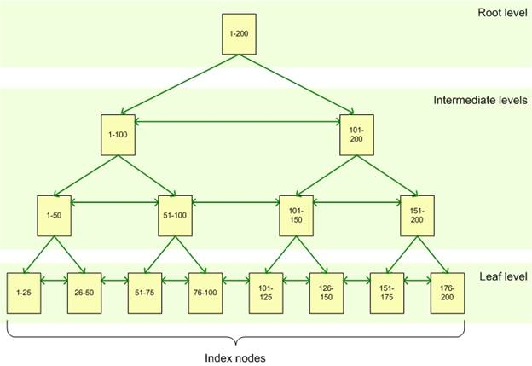
B-tree
Notes:
https://www.simple-talk.com/sql/learn-sql-server/sql-server-index-basics/

Slide 4
Clustered Index
Column for clustered index – clustering key
SQL server order the data in the table according clustering key
The leaf level of CU is data in the table
CU does not always be on primary key

Slide 5
CREATE UNIQUE/CLUSTERED/NONCLUSTERED
INDEX index_name
ON object_name column_name ASC/DESC
[with OPTION ]
[ON partition_scheme (col_name)]

Slide 6
Notes
Primary Key and Unique constraints are implemented as unique index
Object – table or view
Nonclustering – 249 on single table; B-tree structure – the leaf level contains pointer to data

Slide 7
Covering Index
An index that can satisfy the query without having to access the table

Slide 8
Index selection
Server determines whether to use an index by examining only the first column defined in the index!
Example: index defined on FirstName, LastName and query looking for LastName -> this index will not be used

Slide 9
Option
PAD_INDEX – on/off
FILLFACTOR – 0-100% - how full leaf level
SORT_IN_TEMPDB – default is off
IGNORE_DUP_KEY
STATISTICS_NORECOMPUTE
DROP EXISTING
ONLINE
ALLOW_ROW_LOCKS
ALLOW_PAGE_LOCKS
MAXDOP – maximum degree of parallelism, max. 64
Notes:
p. 157

Slide 10
Disabling Index
ALTER INDEX index_name
ON object_name
DISABLE

Slide 11
Maintenance
Do you really need more then 5 indexes on one table?
If the leaf level index page does not have room for new value -> page split

Slide 12
Best practices
All tables should have primary keys
All tables should have clustered index
Identify poorly performing queries -> create nonclustered index
Identify

Slide 13
Index Fragmentation
Insert, update, delete
SQL Server 2005 – 8 KB per index page

Slide 14
Reorganize and Rebuild Index
ALTER INDEX index_name
ON object_name
REBUILD
Rebuild - Droping and recreating index

Slide 15
Find FillFactor Values
Sys.indexes
External fragmentation – physical order of index pages does not match the logical order

Slide 16
Statistics
Statistical information about the distribution of values in a column – used by query optimizer to estimate the cost of using index
Histogram
AUTO_CREATE_STATISTICS = ON/OFF
UPDATE STATISTICS or sp_autostats
Sys.cats – tables
Sys.stat_columns – row for each column from sys.cats

